Slide 1
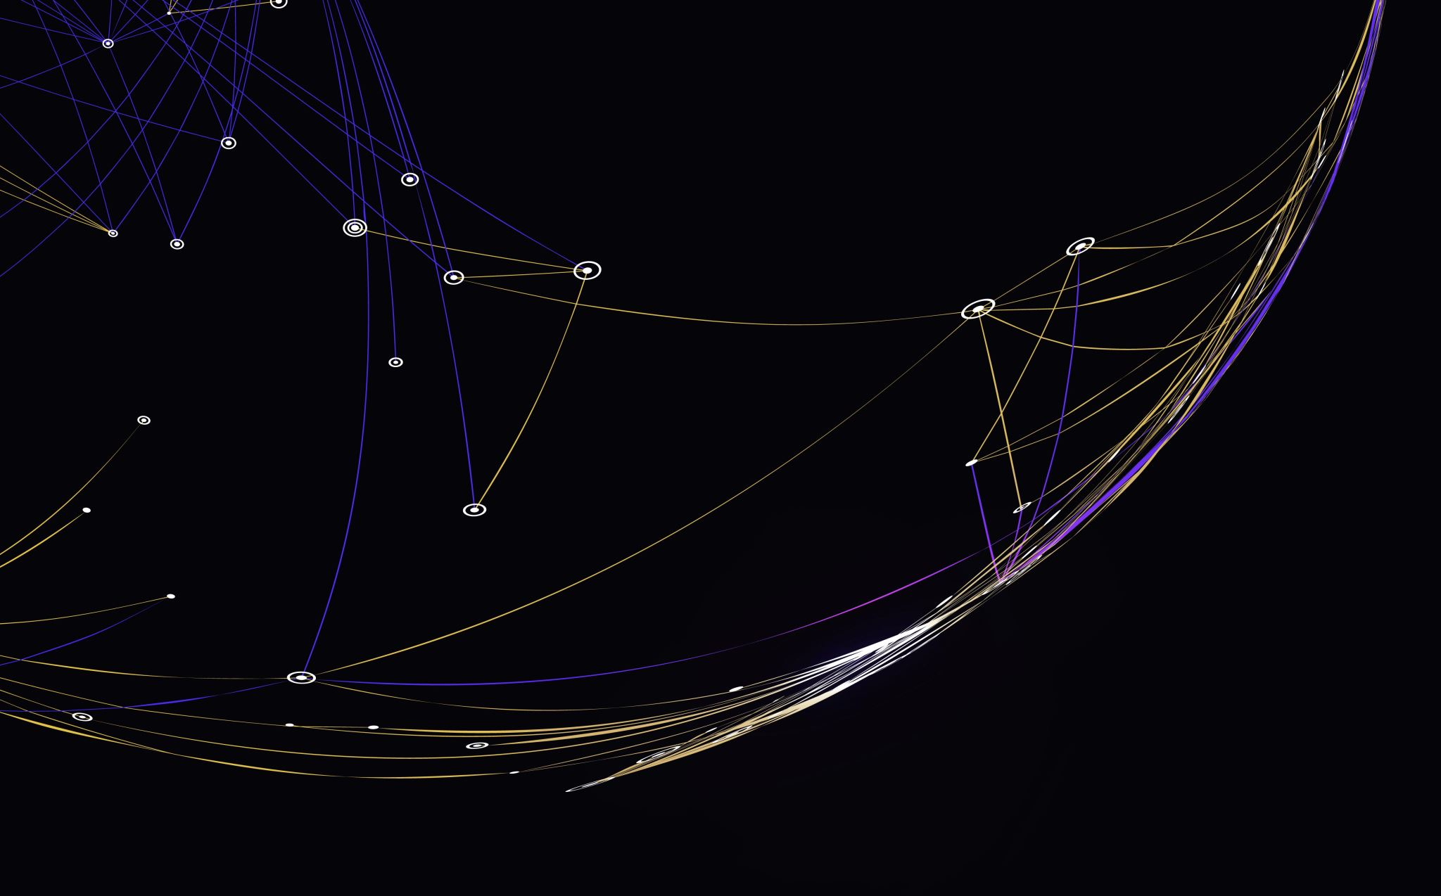
Boundaries
Clean Code – Chapter 8

Slide 2
Using Third-Party Code
Providers of third-party packages and frameworks:
strive for broad applicability so they can work in many environments and appeal to a wide audience.
Users of third-party packages and frameworks:
want an interface that is focused on their particular needs.

Slide 3
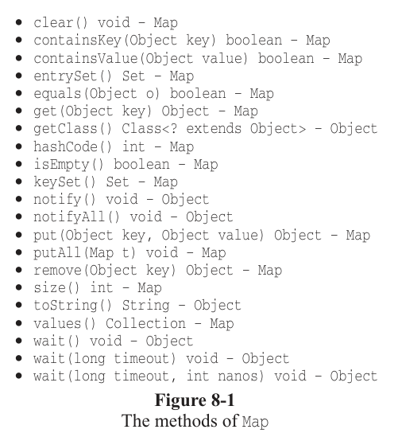
Using Third-Party Code (cont.)
Too much capability: method like clear() could accidently delete all data.
Type safety issues: without proper constraints, anyone could add the wrong type of object to your sensor map.
Widespread coupling: if you pass Map objects around your system, you create dependencies on the Map interface throughout your codebase.

Slide 4
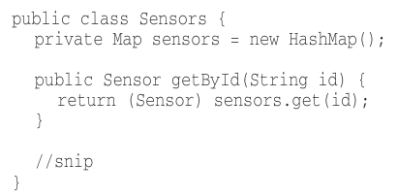
Using Third-Party Code (cont.)
Encapsulation is the solution
instead of exposing third-part interfaces directly, wrap them in your own classes.
Benefits:
Controlled interface.
Easier evolution.
Better encapsulation.
Enforced rules.

Slide 5
Exploring and Learning Boundaries
Benefits and challenges of third-party code:
Faster delivery: they help deliver more functionality in less time.
Not our responsibility: to test the third-party code itself.
Learning curve: takes days or weeks for reading docs.
Integration complexity: combining learning and integration simultaneously is “doubly hard”.
Debugging difficulties: hard to determine if bugs are in our code or the third-party library.

Slide 6
Exploring and Learning Boundaries (cont.)
Instead of experimenting and trying out new stuff in production code, we could write some tests to explore our understanding of the third-party code “learning tests”.
In learning tests, we call the third-party API.
And essentially doing controlled experiments that check our understanding of that API.

Slide 7
Learning log4j
Example: replacing custom logger with Apache log4j.

Slide 8
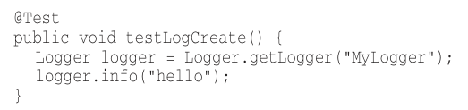
Learning log4j
Basic test:
Result: error - need something called an “Appender”.

Slide 9
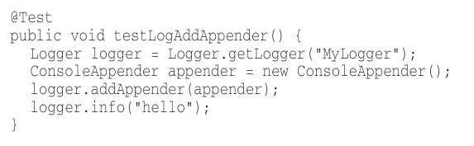
Learning log4j (cont.)
Adding Appender:
Result: appender has no output stream.

Slide 10
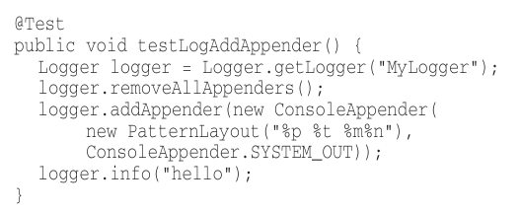
Learning log4j (cont.)
Adding pattern layout:
Result: success! “hello” appears on console.

Slide 11
Learning log4j (cont.)
Strange behavior discovered:
Removing ConsoleAppender.SYSTEM_OUT still prints “hello”.
Removing PatternLayout complains about missing output stream.
Default ConsoleAppender constructor is “unconfigured”.

Slide 12
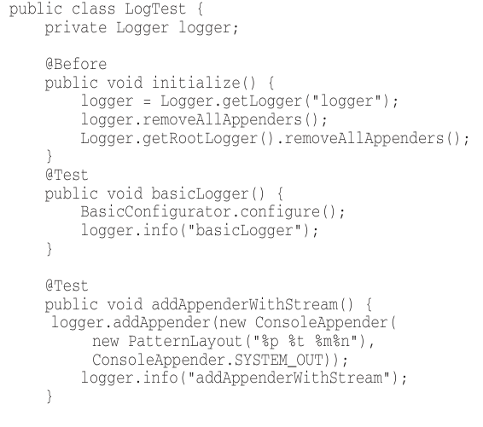
Learning log4j (cont.)
Understanding of log4j behavior encoded in unit tests.
We can now encapsulate this knowledge in our own logger class.
Rest of application isolated from log4j boundary interface.

